Slide 1
Smart parking
SUBMITTED BY
KAVI BHARATH T
auttrtkvl004(transfer student)
kavibharath06112002@gmail.com
Department of electronics and communication engineering
Anna university regional campus,coimbatore

Slide 2
COMPONENTS REQUIRED:
ULTRASONIC SENSOR
OCCUPANCY SENSOR
VIDEO CAMERA
RFID SENSOR
ENTRY AND EXIT GATE SENSOR

Slide 3
SMART PARKING:
A smart parking system is a system that uses sensors and devices to detect the presence and location of vehicles in a parking lot and to display the information to the drivers and the management. It can also provide access control, security, payment, and reservation features. A smart parking system can reduce traffic congestion, pollution, fuel consumption, and parking fees.

Slide 4
WHAT IS RASPBERRY PI_4:
A Raspberry Pi 4 is a small computer that can be used for various projects, such as robotics, home automation, gaming, and more. When combined with different sensors and devices, it can perform various tasks and functions. For example, when combined with an occupancy sensor, an ultrasonic sensor, a video camera, an RFID sensor, and an entry and exit gate sensor, it can be used to create a smart parking system that can monitor and control the availability of parking spaces.

Slide 5
HOW DOES THE RASPBERRY PI 4 WORK HERE?
To create a smart parking system using a Raspberry Pi 4 and the sensors and devices mentioned above, we would need to do the following:
Connect the sensors and devices to the Raspberry Pi 4 using wires and GPIO pins. We would also need a voltage level converter to convert the 5V output from the ultrasonic sensor and the RFID sensor to 3.3V input for the Raspberry Pi 4.

Slide 6
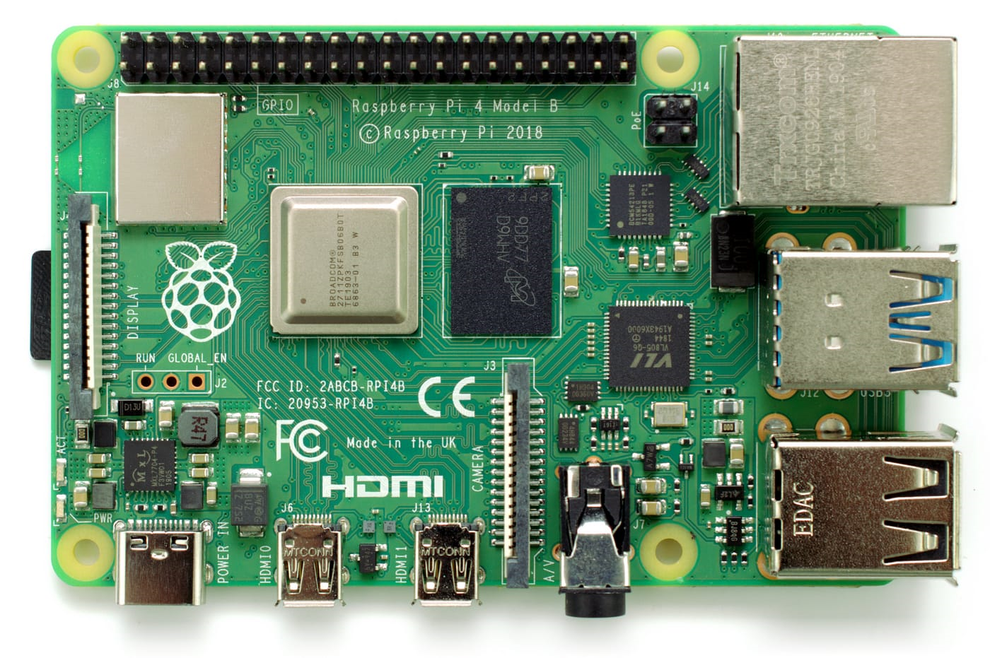
Write some code for the Raspberry Pi 4 using Python or another programming language. We would also need to install some libraries or modules that can communicate with the sensors and devices. For example, we could use RPi.GPIO for controlling the GPIO pins, picamera for accessing the camera module, MFRC522 for reading RFID tags, etc.

Slide 7
PROGRAM:
import RPi.GPIO as GPIO
import spidevimport time
import picamera
import pubnubfrom pubnub.pnconfiguration
import PNConfigurationfrom pubnub.pubnub
import PubNub
import soracom
# Initialize GPIO pins
GPIO.setmode(GPIO.BCM) # use BCM numbering scheme
GPIO.setup(18, GPIO.IN) # set pin 18 as input for occupancy sensor
GPIO.setup(17, GPIO.IN) # set pin 17 as input for entry and exit gate sensor
GPIO.setup(23, GPIO.OUT) # set pin 23 as output for ultrasonic sensor trigger
GPIO.setup(24, GPIO.IN) # set pin 24 as input for ultrasonic sensor echo
GPIO.setup(12, GPIO.OUT) # set pin 12 as output for servo motor

Slide 8
# Initialize SPI bus
spi = spidev.SpiDev() # create spi object
spi.open(0, 0) # open spi port 0, device 0
spi.max_speed_hz = 1000000 # set speed
# Initialize camera object
camera = picamera.PiCamera() # create camera object
camera.resolution = (800, 600) # set resolution
# Initialize PubNub configuration
pnconfig = PNConfiguration()pnconfig.publish_key = "your_publish_key" # replace with your publish key
pnconfig.subscribe_key = "your_subscribe_key" # replace with your subscribe key
pnconfig.ssl = False
# Initialize PubNub object
pubnub = PubNub(pnconfig)

Slide 9
# Initialize Soracom configuration
soracom_config = soracom.Config()
soracom_config.api_key = "your_api_key" # replace with your api key
soracom_config.token = "your_token" # replace with your token
# Initialize Soracom client
soracom_client = soracom.Client(soracom_config)
# Initialize servo motor
servo = GPIO.PWM(12, 50) # create PWM object on pin 12 with 50 Hz frequency
servo.start(0) # start PWM with 0% duty cycle
# Define function for reading occupancy sensor value
def read_occupancy():
occupancy = GPIO.input(18) # read pin 18 value
if occupancy == 1: status = "Occupied"
else:
status = "Vacant“
return status

Slide 10
# Define function for reading entry and exit gate sensor value
def read_gate():
vehicle = GPIO.input(17) # read pin 17 value
if vehicle == 1:
status = "Vehicle detected“
else:
status = "No vehicle detected“
return status
# Define function for reading ultrasonic sensor value
def read_distance():
# Set trigger to HIGH
GPIO.output(23, True)
# set trigger after 0.01ms to LOW time.sleep(0.00001)
GPIO.output(23, False)
# Save start time
while GPIO.input(24) == 0:

Slide 11
start_time = time.time()
# Save arrival time
while GPIO.input(24) == 1:
arrival_time = time.time()
# Calculate time difference between start and arrival
time_difference = arrival_time - start_time
# Multiply with the sonic speed (34300 cm/s)
# and divide by 2, because there and back
distance = (time_difference * 34300) / 2
return distance
# Define function for reading RFID sensor value
def read_rfid():
uid = spi.xfer([0x93, 0x20]) # send request for UID
return uid
# Define function for controlling servo motor
def control_servo(angle):
duty_cycle = (angle / 18) + 2 # calculate duty cycle based on angle

Slide 12
servo.ChangeDutyCycle(duty_cycle)
# change duty cycle to desired value
# Define function for capturing image from camera
def capture_image(filename):
camera.capture(filename)
# capture image and save as file
# Define function for publishing message to PubNub
def publish_message(channel, message):
pubnub.publish().channel(channel).message(message).sync() # publish message synchronously
# Define channel name for publishing message
Channel = "parking“
# Define loop for reading sensor values and performing actions
while True:
occupancy = read_occupancy()

Slide 13
# read occupancy sensor value
gate = read_gate() # read gate sensor value
distance = read_distance() # read ultrasonic sensor value
rfid = read_rfid() # read RFID sensor value
if gate == "Vehicle detected": # if vehicle is detected at the gate
print(gate)
if rfid == [143, 32]: # if RFID tag is valid (replace with your tag value)
print("Valid tag")
control_servo(90) # rotate servo motor to 90 degrees (open gate)
time.sleep(3) # wait for 3 seconds
print("Gate opened")
capture_image("entry.jpg") # capture image of vehicle at entry
control_servo(0) # rotate servo motor to 0 degrees (close gate)
time.sleep(3) # wait for 3 seconds
print("Gate closed")

Slide 14
else: # if RFID tag is invalid
print("Invalid tag")
print("Access denied")
capture_image("denied.jpg") # capture image of vehicle at denied access
elif occupancy == "Occupied": # if parking spot is occupied
print(occupancy)
message = {"status": occupancy} # create message object with occupancy status
publish_message(channel, message) # publish message to PubNub channel
capture_image("occupied.jpg") # capture image of parking spot when occupied
elif occupancy == "Vacant": # if parking spot is vacant
print(occupancy)
message = {"status": occupancy}
# create message object with occupancy status
publish_message(channel, message) # publish message to PubNub channel
capture_image("vacant.jpg") # capture image of parking spot when vacant

Slide 15
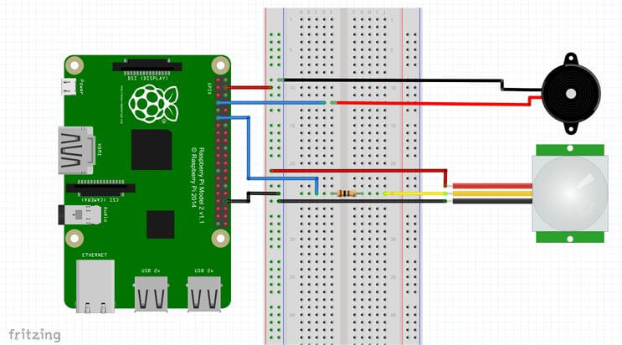
else: # if no sensor value is detected
print("No sensor value detected")
time.sleep(1) # wait for 1 second before next iteration
By applying this program we can simulate the process of sensors in real time and can be monitered through a mobile app
The occupancy sensor detects if a parking space is empty or full. It sends a signal to the Raspberry Pi.

Slide 16
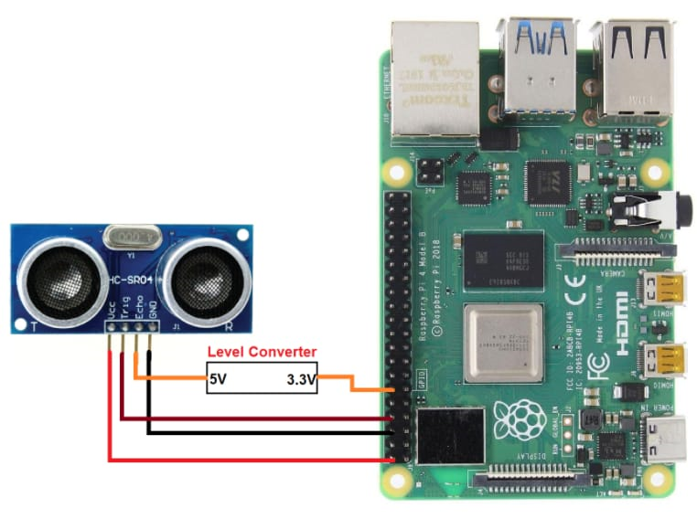
The ultrasonic sensor measures the distance of a car from the gate. It sends a pulse and receives an echo. The Raspberry Pi calculates the time difference.

Slide 17
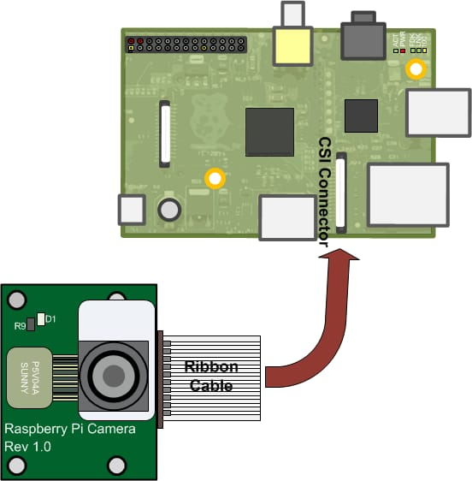
The video camera captures images or videos of the parking lot. The Raspberry Pi uses computer vision to recognize license plates or track cars.

Slide 18
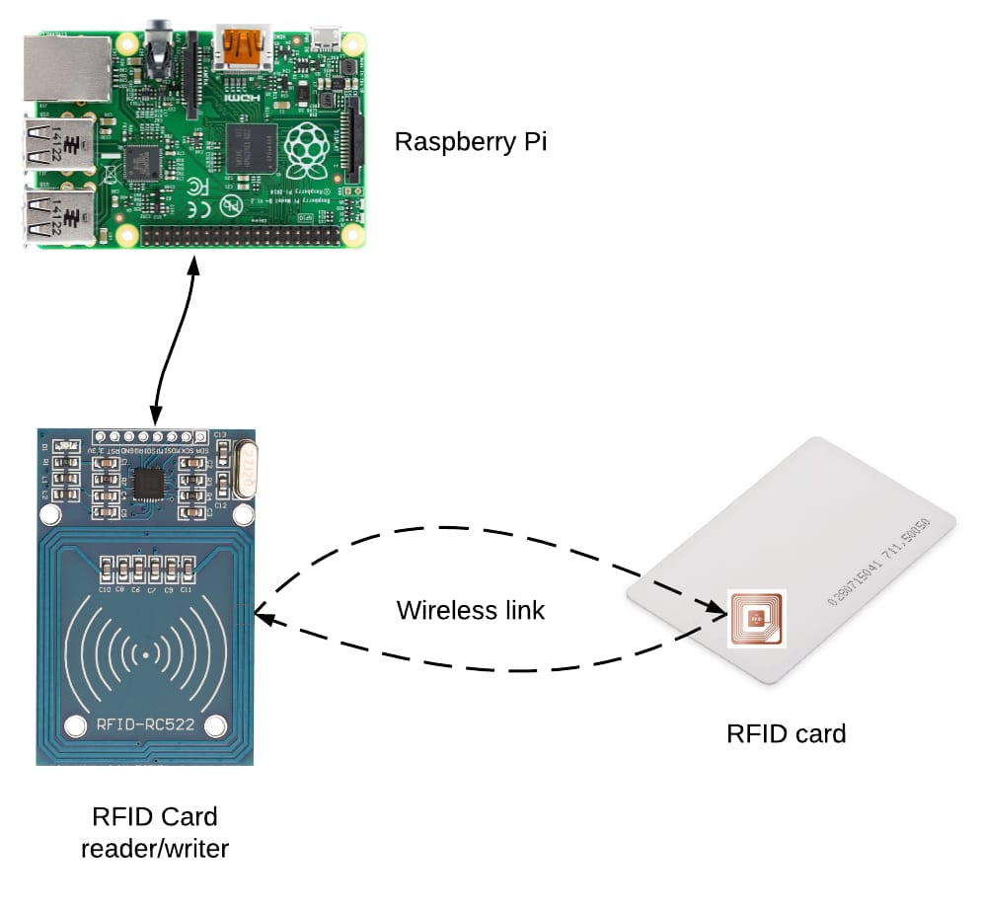
The RFID sensor reads the tags on the cars. It sends data to the Raspberry Pi using I2C. The Raspberry Pi identifies or authorizes the cars.

Slide 19
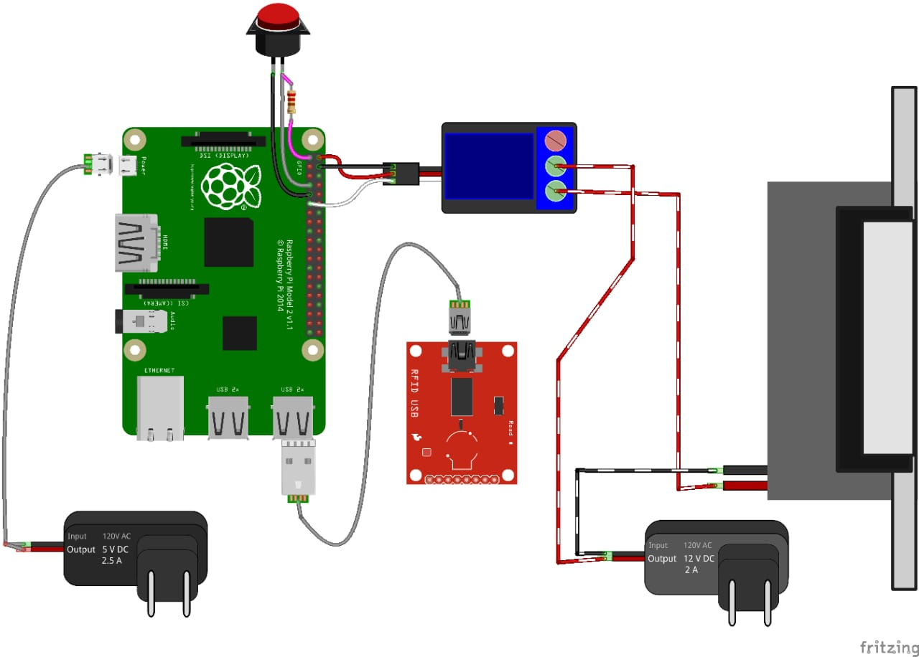
The entry and exit gate sensor detects if the gate is open or closed. It sends a signal to the Raspberry Pi. The Raspberry Pi controls the gate using a motor or a speaker.

Slide 20
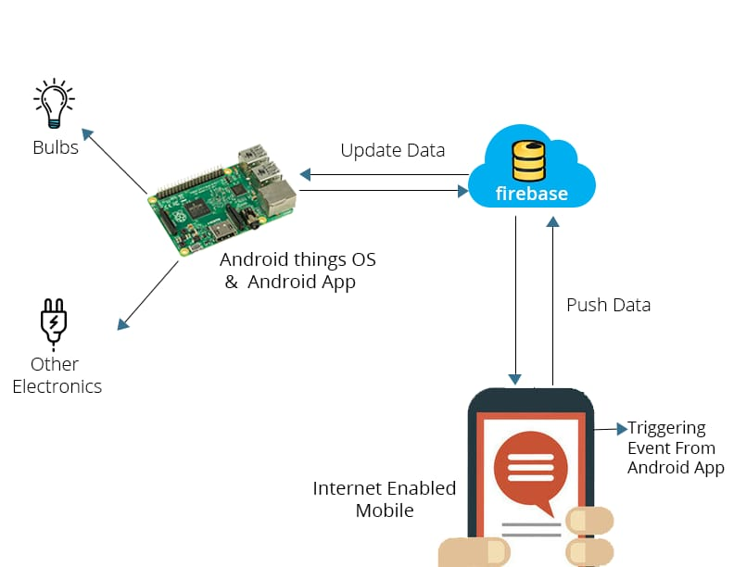
Mobile app:
All the functions mentioned in the previous slides can be monitered using the mobile app we have created and can receive notifications about the availability of the space in parking lot and we can use this app to operate the smart parking system using relay sytem

Slide 21
THANK YOU

